Slide 1
10 Typology of relative clauses
ENG 452: Linguistic Typology

Slide 2
Introduction
We examine the typology of relative clauses.
Clauses may occur within NPs as either complements or modifiers.
A clause that functions as a modifier within the NP is called a relative clause.
Eg
(1) Clausal modifiers (Relative clauses)
a) the woman [that I love]
b) the food [that I love]
c) the color [that I love]
d) the idea [that I love]
e) the theory [that I love]

Slide 3
Because the modifying clause is a kind of adjunct, nearly any head noun can occur in this pattern.
In contrast, clausal complements are allowed only with certain specific head nouns, most commonly with nouns describing verbal or mental activities.
Example (2) shows that some nouns accept such complement clauses while others do not.
(2) Clausal complements
a) the report [that I love Mary]
b) the idea [that I love Mary]
c) the theory [that I love Mary]
d) ∗the woman [that I love Mary]
e) ∗the food [that I love Mary]
f) ∗the color [that I love Mary]

Slide 4
So, a relative clause is a clause which modifies the head noun within a noun phrase.
Consider the following example:
(3) [The woman [that I love]_{S’}] _{np} is moving to Delhi.
This example illustrates the three basic parts of a relative clause construction: the head noun (woman), the modifying clause (I love), and the relativiser (that) which links the modifying clause to the head.
Notice that the modifying clause is incomplete: it lacks a direct object, even though its verb (love) requires one. Of course, this example is acceptable because the head noun is “understood” to be the object of love.
Thus, the head noun actually has two different roles in this example: it functions as the subject of the main clause, but at the same time, it is interpreted as being the object of the modifying clause.

Slide 5
The process is known as relativization.
Relativization is the process of forming a relative clause construction.
A relative clause is a kind of subordinate clause that modifies the noun phrase (NP) of the main clause; that is to say, the head of the noun phrase is modified by the embedded clause.
In English, where a relative clause is usually introduced by a relative pronoun like who, that, which, whose, and whom (where, when, and why are also possible).

Slide 6
we will be primarily concerned with
the internal structure of the relative clause, and
the position of the modifying clause relative to the head noun; the nature of the relativizer, if any; the function which the head noun is understood to fill within the modifying clause, and the manner in which this function is indicated.
But before we turn to these structural issues, let us briefly discuss the semantic function of relative clauses.

Slide 7
Restrictive vs. non-restrictive relative clauses
In (3 repeated below), the head of the relative clause (woman) is a common noun which could refer to any one of a few billion individuals.
(3) [The woman [that I love]_{S’}] _{np} is moving to Delhi.
The function of the modifying clause is to identify (uniquely, one would hope) which particular woman the speaker is referring to. This is a typical example of a restrictive relative clause.
In this construction, the reference of the NP as a whole is determined in two stages: the head noun designates a class which the referent must belong to; and the modifying clause restricts (or narrows) the identity of the referent to a specific member of that class.
Not all relative clauses work this way.
A non-restrictive relative clause is one in which the referent of the head noun can be identified independently, and the clausal modifier simply presents additional information about that referent.

Slide 8
The difference between restrictive and non-restrictive relative clauses is illustrated in (4).
In (4a) the head is a common noun which identifies the class of men in general. The modifying clause serves to identify which particular man the speaker is talking about.
In (4b), on the other hand, the head is a proper name; this indicates that the speaker assumes that the hearer already knows who Al Capone is. The clausal modifier serves only to provide additional background information about this individual.
(4) a. restrictive:
The police are looking for [the man who escaped from prison yesterday].
b. non-restrictive:
The police are looking for [Al Capone, who escaped from prison yesterday].
Thus in restrictive relative clauses, like (4a), the modifying clause contains old or presupposed information while the identity of the referent is new information. But in non-restrictive relative clauses, like (4b), the identity of the referent is old information while the modifying clause contains new information.

Slide 9
In many languages there is little or no difference in grammatical structure between restrictive and non-restrictive relative clauses, but this is not always the case.
In a restrictive relative clause like (5), the modifying clause may be introduced by that, a Wh- word, or Ø.
(5) a) The woman whom I love is moving to Delhi.
b) The woman that I love is moving to Delhi.
c) The woman I love is moving to Delhi.
But in a non-restrictive relative clause like (6), the modifying clause must be introduced by a Wh- word; the use of that or Ø makes the construction ungrammatical.
(6) a) Mary, whom I dearly love, is moving to Delhi.
b) *Mary, that I dearly love, is moving to Delhi.
c) *Mary, I dearly love, is moving to Delhi.

Slide 10
Types of Relative Clause:
(Relationship between the main clause and the relative clause)
1. Externally headed relative clauses
In English, as all of the preceding examples illustrate, the modifying clause always follows the head noun. This is probably the most common ordering of these elements across languages, but it is certainly not the only possibility.
A large number of languages have the opposite order, with the modifying clause preceding the head noun.
Both of these possibilities are examples of externally headed relative clauses, i.e. those in which the head noun occurs outside the modifying clause, whether before or after.
The other possibility, namely an internally headed relative clause, is quite rare

Slide 11
If we examine externally headed relative constructions in many different languages, we will discover a partial correlation between the position of the modifying clause (before or after the head noun) and other word order facts in the language.
Verb-initial languages (those in which the verb occurs first in a basic declarative sentence, whether VSO or VOS) almost always have postnominal (or post-posed) relative clauses, with the modifying clause following the head noun.
A large number of verb-final (SOV) languages have prenominal (or pre-posed) relative clauses, with the modifying clause preceding the head noun.
Turkish example (SOV)
(7) [John=’un Mary=ye ver-dig-i] patates=i yedim.
John=gen Mary=dat give-nmlz-his potato=acc I.ate
I ate the potato that John gave to Mary.’
(lit.: ‘I ate the potato of John’s giving to Mary.’)

Slide 12
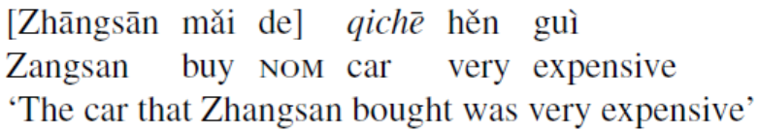
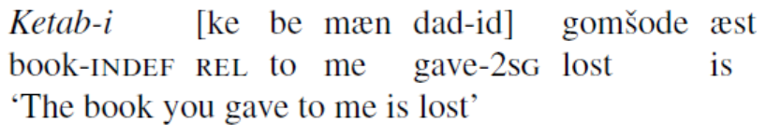
Languages in which RCs precede the domain nominal are especially likely to be verb-final – such as Japanese, Korean, Turkish, and Navajo – although RC-first order also occurs in SVO languages such as Chinese (Li and Thompson (1981:116)): [RCs means relative clause]
(8)
But other verb-final languages have postnominal relative clauses instead.
Eg. Persian (SOV)

Slide 13
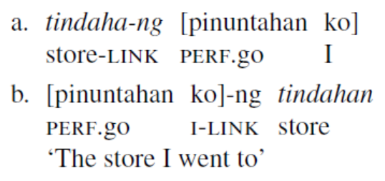
It is also possible, although unusual, for RCs to be able to either precede or follow the domain nominal. This occurs in Tagalog (Schachter and Otanes (1972:124)):
Here the RC is separated from the domain nominal by a so-called ‘linker’, which appears between the RC and the domain nominal, regardless of what order these appear in.

Slide 14
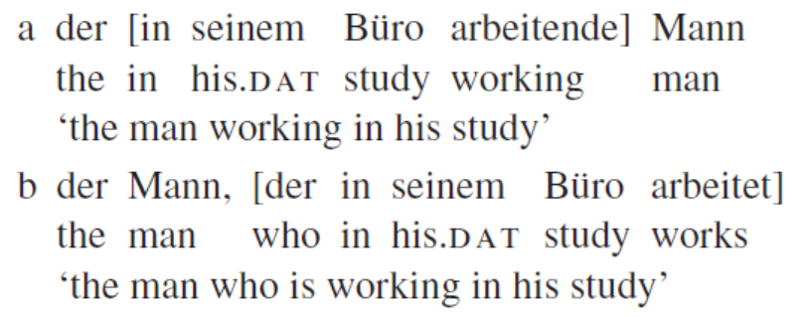
Another common pattern is for the verb inside the modifying clause to appear as a participle. German has two kinds of relative clauses: a prenominal relative containing a participial form of the verb (xa); and a postnominal relative containing a normal finite verb form (xb). Note that English also allows participial relatives, as illustrated in the translation of (xa).

Slide 15
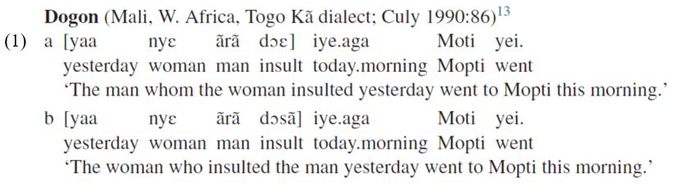
2. Internally headed relative clauses
As mentioned above, a few languages have internally headed relative clauses, in which the head noun appears inside the modifying clause. The examples in (1) are from Dogon, a language of West Africa.
Notice that the head noun (‘woman’ in 1a, ‘man’ in 1b) lies inside the modifying clause in both examples.
The two sentences are identical, except for the form of the verb in the modifying clause (‘insult’), which indicates whether the head noun is the subject (as in 1b) or a non-subject element (as in 1a).

Slide 16
There are three types of relative clauses that are found in the South Asian subcontinent.
They include:
(i) externally headed relative clauses (EHRCs) [also found in Tibeto-Burman languages]
(ii) Relative-Correlative clauses; and
(iii) internally headed relative clauses (IHRCs) [also found in Tibeto-Burman languages]
Relative-Correlative clauses:
We have seen the EHRC and IHRC, now we shall look at the Relative-Correlative clauses construction.
The Relative-correlative clauses are sentential, as in Indo-Aryan and less commonly in Dravidian
One of the significant characteristic features of SALs is the occurrence of the relative-correlative clauses, which are common only in SOV languages, according to Downing (1978) and Keenan (1985). finite embedded clause.

Slide 17
Relative-Correlative clauses
In the relative-correlative construction, there is the occurrence of a relative pronoun and a correlative pronoun, which are co-indexed with each other.

Slide 18
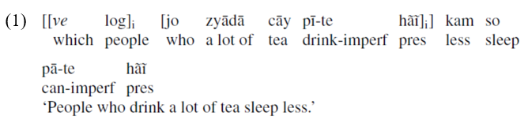
Relative clause in Hindi
1. EHRC
Pattern 1. post-nominal sentential relative clause [part of EHRC]
Post-nominal relative clauses may occur either: (a) immediately to the right of the head noun, which we shall label as NP-adjoined relative clauses; or (b) to the right of the VP of the matrix clause, which we shall label as the extraposed (CP-adjoined) relative clause.
Sentence (1) is an example of a post-nominal relative clause where the embedded relative clause occurs immediately to the right of the head noun.
Post-nominal relative clause: NP-adjoined
Hindi-Urdu (IA)

Slide 19
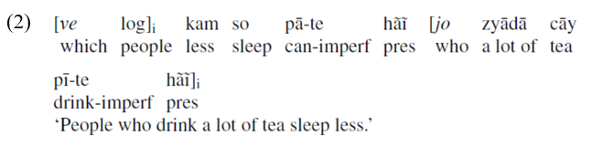
In pattern 1, the embedded relative clause may also occur to the right of the matrix VP, in which case the relative clause is away from the head and is not adjacent, as in (2). The embedded relative clause is thus considered extraposed and is right-adjoined to CP.
the right-adjoined to cp or the extraposed relative clause
The right-adjoined relative clause together with the head in (1) forms a DP constituent, while the CP-adjoined or extraposed relative in (2) does not form a DP constituent, as it is away from its head.

Slide 20
Pattern 2. EHRC: embedded verb is infinitival or participial
All the SALs have the EHRC, in which the coreferential NP of the embedded clause is a covert operator which does not occur overtly. We have indicated it by ø in the examples given later.
Thus, if the head noun of the embedded clause is a covert operator occurring in a specific position, such as Subject (S), Direct Object (DO), Indirect Object (IO), Oblique Object (OO) or Object of the Genitive (OGEN) of the embedded clause, and the head occurs only in the matrix clause, it is called an externally headed relative clause (EHRC), which is non-finite.
It is that specific position in the embedded clause that is targeted in an EHRC and it is that position that is relativized. Thus, in sentence (3) in Hindi-Urdu (IA), for example, the direct object of the embedded clause is kapr. e ‘clothes,
All pre-nominal relatives in Dravidian and Indo-Aryan are participial.

Slide 21
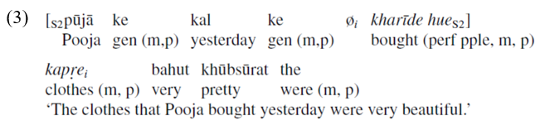
Direct object modified EHRC
Hindi-Urdu (IA)

Slide 22
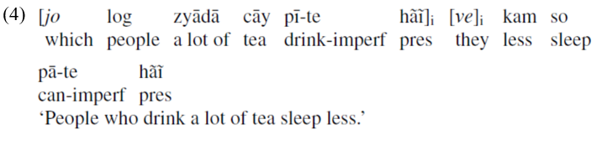
2. The relative-correlative clause
An example of the relative-correlative type is provided in (4) below. Such clauses are predominantly found in SALs and they tend to occur only in verb-final languages. Since the relative-correlative type occurs only as a prenominal relative clause, it is called a pre-nominal relative-correlative clause.
In (4) in Hindi-Urdu (IA), the relative pronoun jo ‘which’ functions as a relative determiner and ve ‘they’ in the matrix clause is labeled as the correlative pronoun or correlate. In Dravidian too the relative pronoun functions as a relative determiner when followed by a lexical noun such as boy, girl, animal, stone, etc.
pre-nominal relative-correlative clause
Hindi-Urdu (IA)

Slide 23
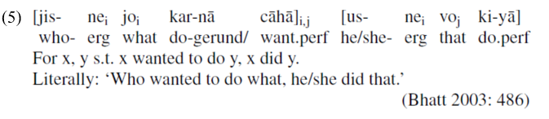
In Indo-Aryan languages there are Multi-Head relative clauses (Bhatt 2003: 491) as in (5), which are invariably the relative-correlative type.
Multi-Head correlative
Multi-head relative clauses, as in (6), are invariably the relative-correlative type and not extraposed. They generally have the interpretation of a relative clause where the head is [−definite].
Multi-head correlative
Multi-Head correlatives are found in all the Indo-Aryan languages (Bhatt 2003: 486) and also in Dravidian Languages.

Slide 24
3. Internally headed relative clauses (IHRCs) (found in some verb final languages esply in TB lgs)
The third type of clauses are the IHRCs in which the head occurs internally in the embedded relative clause and it is not overtly present in the matrix clause. IHRCs are found only in verb-final languages (Keenan 1985).7
All Tibeto-Burman languages are verb-final and most of them have the IHRC. The internal head is in italics in examples (7) and (8). The letter ø in (7) and (8a) indicates the empty category (a null pro) that occurs in the matrix clause, and is coindexed with the head in the embedded clause. The embedded verb in an IHRC is an infinitival/nominalized form, as all IHRCs in Tibeto-Burman languages are the result of nominalization of the embedded clause.
There are two types of IHRCs in Tibeto-Burman. The internal head in an IHRC may or may not carry a postposition.

Slide 25
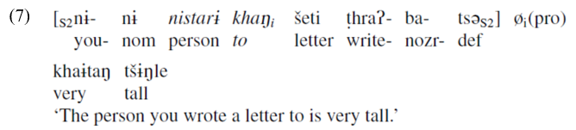
Type A: Internally Headed Relative Clause (IHRC) with an overt postposition
When the IO is the head of an IHRC, the dative postposition khaŋ ‘to’ is overtly present in Sangtam (TB). The head nistar ‘person’ occurs in the embedded clause.
indirect object modified – dative case-marked io as head of an ihrc
Sangtam (TB)

Slide 26
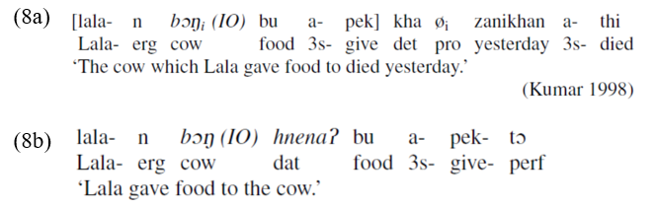
Type B: Internally Headed Relative Clause (IHRC) with no overt postposition
indirect object modified – dative case-marker not present with io as head of an ihrc
Type B consists of an IHRC in which the postposition indicating the grammatical relation of the head noun phrase with the embedded verb is not overtly present.
indirect object modified – IO as head of an IHRC with no overt postposition
Hmar (TB)
Note that the dative postposition hnenaʔ ‘to, for’ with the internal head bɔŋ ‘cow’ is not present in (8a), while in a simple sentence (8b) its presence is obligatory.

Slide 27
References
Andrews, Avery D. 2007. Relative clauses. In T. Shopen (ed.), Language typology and
syntactic description. Volume 2: Complex constructions (second edition), 206-236. Cambridge: Cambridge University Press.
Kroeger, P. (2005). Analysing Grammar: An Introduction. Cambridge University Press.
Subbarao, K. V. (2012). South Asian Languages: A Syntactic Typology. Cambridge.

